Slide 1
🔷 DLT (Delta Live Tables)

Slide 2
What is DLT?
Delta Live Tables (DLT) is a framework in Databricks used to build reliable ETL pipelines using SQL or Python on top of Delta Lake.
It automatically manages data quality, dependency management, orchestration, and monitoring.

Slide 3
🔹 Why DLT?
Without DLT:
You write manual Spark jobs
Handle checkpoints manually
Build your own monitoring
Manage dependencies yourself
With DLT:
Automatic dependency management
Built-in data quality rules (Expectations)
Automatic error handling
Pipeline monitoring UI
Production-ready pipelines

Slide 4
🔹 Where DLT is Used?
Mostly in:
Medallion Architecture (Bronze → Silver → Gold)
Streaming pipelines
Incremental data loads
Data warehouse ETL
Real-time dashboards

Slide 5
Types of Tables in Delta Live Tables
DLT mainly supports 3 table types.
Type | Purpose | Storage | Example Use
Streaming Table | Processes streaming data continuously | Stored | Kinesis/ Event streaming
Materialized View (Live Table) | Batch transformation | Stored | Silver / Gold tables
Temporary Table (View) | Intermediate transformations | Not stored | Data cleaning step

Slide 6
1️⃣ Streaming Table
Used for real-time streaming ingestion.
CREATE STREAMING TABLE orders_raw AS SELECT * FROM STREAM read_kinesis( streamName => "orders-stream", region => "us-east-1", initialPosition => "LATEST" );
Key Points
✔ Used for streaming sources ✔ Processes continuous incoming data ✔ Typically used in Bronze layer

Slide 7
Configuration for Streaming Table
Steps to Get AWS Access Key & Secret Key
Step 1: Open IAM Console
Go to AWS Identity and Access Management Console URL:
https://console.aws.amazon.com/iam
Step 2: Create / Select User
Click Users
Click Create user
Give name (example)
databricks-kinesis-user
Enable:
✔ Programmatic access

Slide 8
Step 3: Attach Permissions
Add policy for Kinesis access.
Example policy:
AmazonKinesisFullAccess
{
"Version": "2012-10-17",
"Statement": [
{
"Effect": "Allow",
"Action": [
"kinesis:DescribeStream",
"kinesis:GetRecords",
"kinesis:GetShardIterator",
"kinesis:ListStreams"
],
"Resource": "*"
}
]
}

Slide 9
Step 4: Create Access Keys
After creating the user AWS will show:
Access Key ID Secret Access Key
Example:
Access Key ID: AKIA************ Secret Access Key: abcdefghijklmnopqrst

Slide 10
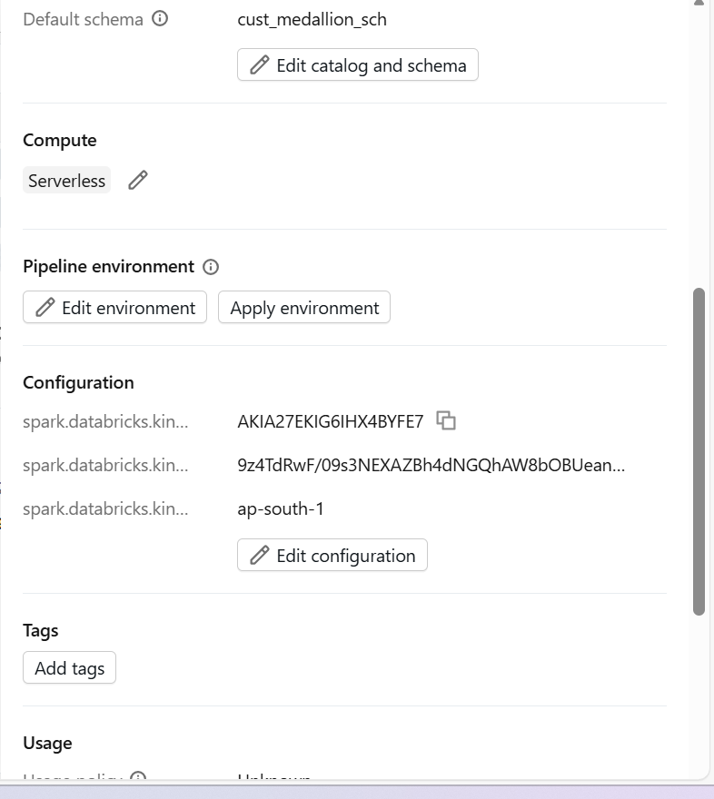
Configure them in pipeline
Go to settings
Edit configuration and add paramters

Slide 11
Materialized View (Live Table)
These are persistent tables created after transformation.
Features
✔ Stored as Delta tables ✔ Used for Silver and Gold layers ✔ Supports incremental updates
Example Use Case
Cleaned data
Aggregated metrics
Business reports

Slide 12
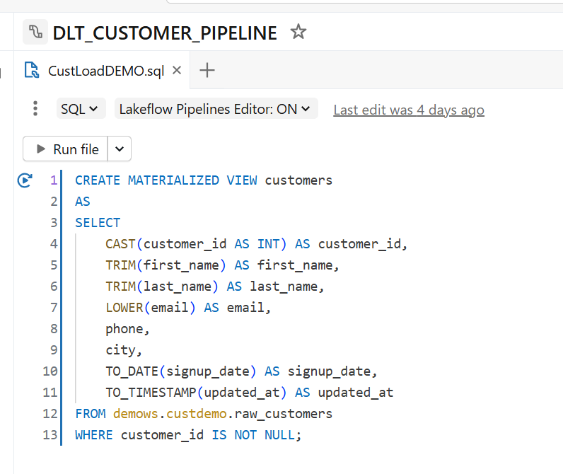
Materialized View (Live Table)

Slide 13
CREATE MATERIALIZED VIEW customers
AS
SELECT
CAST(customer_id AS INT) AS customer_id,
TRIM(first_name) AS first_name,
TRIM(last_name) AS last_name,
LOWER(email) AS email,
phone,
city,
TO_DATE(signup_date) AS signup_date,
TO_TIMESTAMP(updated_at) AS updated_at
FROM demows.custdemo.raw_customers
WHERE customer_id IS NOT NULL;

Slide 14
Temporary Table (View)
Used only inside the pipeline for intermediate processing.
Features
✔ Not stored physically ✔ Used for intermediate logic ✔ Improves pipeline readability

Slide 15
🔹 Key Concepts in DLT
1️⃣ LIVE Tables
CREATE OR REFRESH LIVE TABLE customers AS SELECT * FROM bronze.customers_raw;
LIVE means the table is managed inside DLT pipeline.

Slide 16
2️⃣ Streaming Tables
CREATE OR REFRESH STREAMING LIVE TABLE bronze_orders AS SELECT * FROM cloud_files('/mnt/orders', 'json');
Used for real-time ingestion.
3️⃣ Expectations (Data Quality)
CREATE OR REFRESH LIVE TABLE silver_orders CONSTRAINT valid_amount EXPECT (amount > 0) AS SELECT * FROM LIVE.bronze_orders;
Options:
EXPECT
EXPECT OR DROP
EXPECT OR FAIL

Slide 17
import dlt
from pyspark.sql.functions import col
@dlt.table
@dlt.expect_or_drop("valid_amount", "amount > 0")
def silver_orders():
return spark.read.table("bronze.orders")

Slide 18
🔹 Pipeline Modes
Mode | Purpose
Development | Testing
Production | Stable scheduled runs
Triggered | Runs once
Continuous | Streaming mode

Slide 19
🔹 Advantages of DLT
✅ Auto scaling ✅ Auto retries ✅ Built-in monitoring ✅ Data quality metrics ✅ Incremental by default ✅ Less code

